Slide 1
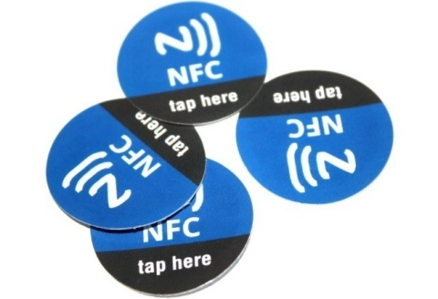
Student Transport Tracking With Near Field Communication
Major Project
Under Guidance Of: Submitted By:
Ms.Sakshi Malhotra Harshit Trivedi
Astt. Proff, Deptt Of CSE 06496502710

Slide 2
Contents
Introduction
About The Project
Process & Installation
Softwares Used
References

Slide 3
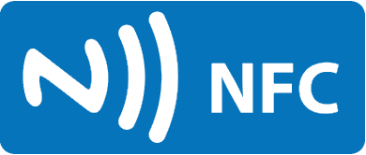
Introduction To NFC
I
Near Field Communication, or NFC is a wireless technology which allows for the transfer of data such as text or numbers between two NFC enabled devices, typically requiring a distance of 4cm or less to initiate a connection.
NFC allows you to share small payloads of data between an NFC tag and an Android-powered device, or between two Android-powered devices.
NFC is an upgrade of the existing proximity card standard (RFID) that combines the interface of a smartcard and a reader into a single device.

Slide 4
How It Works
To access NFC features on smartphones and tablets, those devices need to hold a NFC chip that would handle NFC communications.
It is a technology built upon radio-frequency identification (RFID), which allows a gadget to send radio waves to another gadget or to another RFID-enabled tag and trigger a certain action.

Slide 5
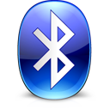
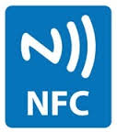
Uses
Situation–based Profiling for driving, meetings, gym workouts and home to suit your work environments at just a touch of a tag.
Give access to your Wi-Fi network
Secure remote PC log-on and log-off
Quick Bluetooth Pairing - + = Wireless Nirvana
Cashless/Contactless Payments
Smart Transit and Ticketing
Multiplayer Gaming
and many more to come in the near future…

Slide 6
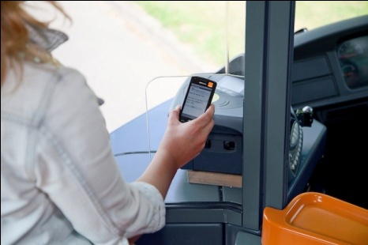

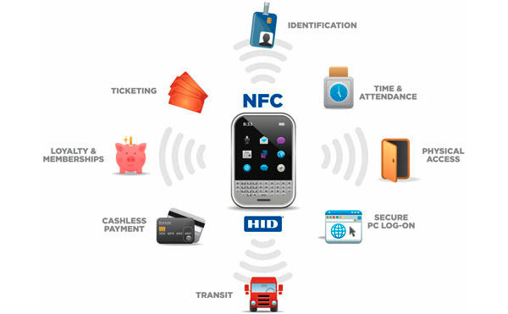
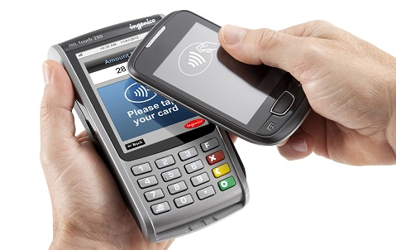
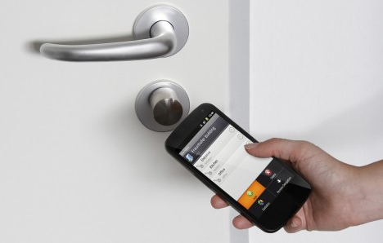
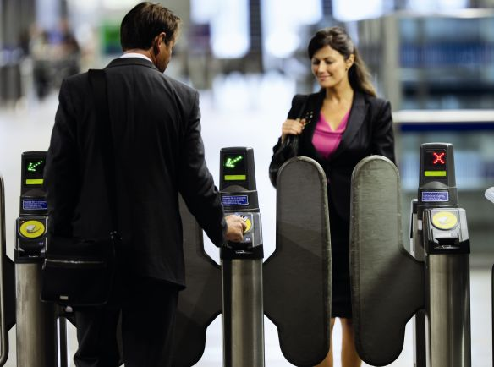
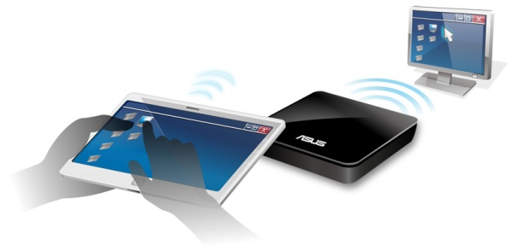

Slide 7
How does it compare to other tech?
NFC operates at slower speeds than Bluetooth, but consumes far less power and doesn't require pairing.
With a maximum working distance of less than 20 cm, NFC has a shorter range, which reduces the likelihood of unwanted interception.
NFC devices are able to receive and transmit data at the same time.
Peer-to-peer communication is a feature that sets NFC apart from typical RFID devices. An NFC device is able to act both as a reader and as a tag.

Slide 8
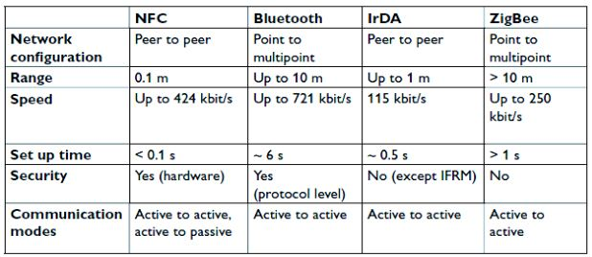
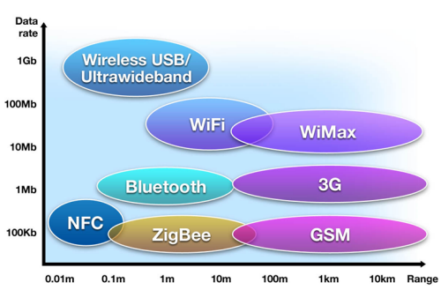

Slide 9
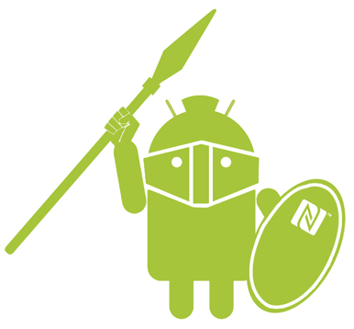
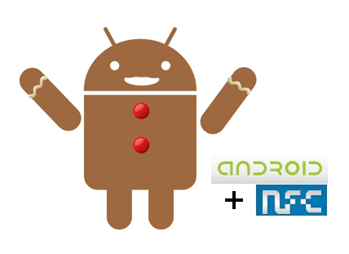
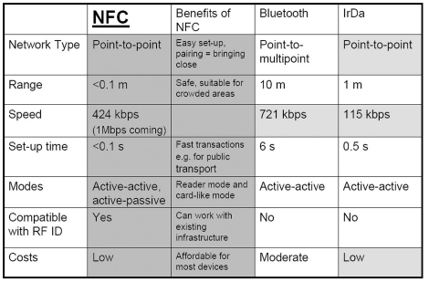
Advantages

Slide 10
About The Project
II
“Student Transport Tracking With NFC”
takes advantage of
These 3 applications of NFC

Slide 11

Student Transport Tracking With NFC
‘Student Transport Tracking With NFC’ is a smart NFC integrated application for Android powered smartphones that enables any institution to track the students’ transportation activity between home and school.
It saves the getting-on and getting-off time of every student on the bus, which is done by reading the NFC student ID cards through an NFC-enabled Android smartphone present with the driver.
It has the ability to write and register a new ID tag for a new student too. The application also has the ability to send the day’s transport tracking record to the Dean, the Transport Incharge or the parents of the students.
In this way, an institution can monitor and track every student’s transportation record, and at the same time parents can be relaxed and untroubled about their child’s whereabouts.

Slide 12
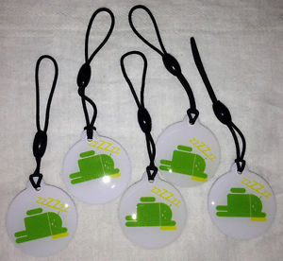
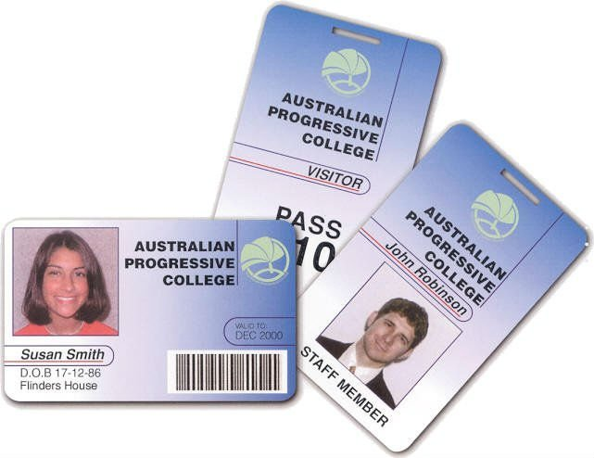
Process And Installation
III
Step I : It is assumed that :
Inside the school bus, there is an NFC-enabled mobile phone, possibly owned by the driver that reads the tags of the students.
Every student is equipped with a NFC Student ID Tag/Card.

Slide 13
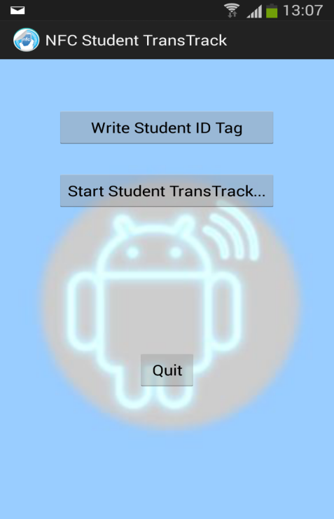
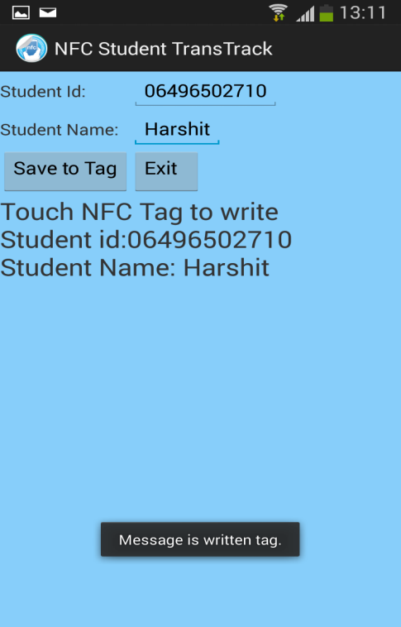
Process And Installation (contd.)
Step II : For an unregistered student:
To write a new Student ID Tag, tap “Write Student ID Tag”.
Fill the student’s details.
Tap “Save To Tag” to write this data to a new tag.
Message is written to tag toast shows successful write operation.

Slide 14
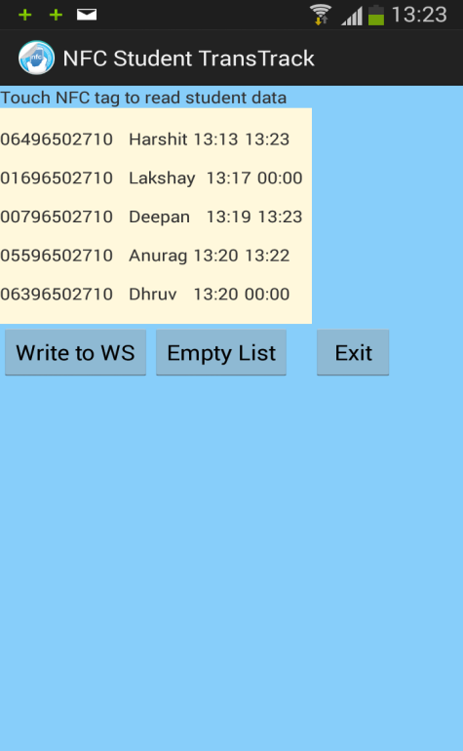
Process And Installation (contd.)
Step III : To start “Student TransTrack”:
Tap “Start Student TransTrack… ”.
When the student touches his/her student ID Tag to device for the 1st time, it records student details along with their getting-on time.
Similarly, on touching student ID Tag to device for the 2nd time, it records student details along with their getting-off time.

Slide 15
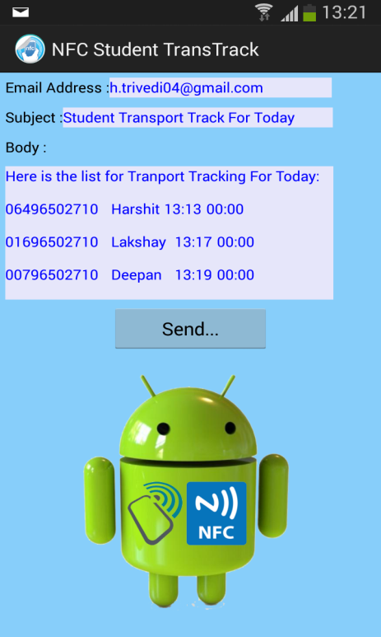
Process And Installation (contd.)
Step III : To send a mail to higher authorities:
Tap “Send Mail…”
The next screen shows the auto-drafted mail recepient and mail subject and body.
On clicking “Send…”, the application redirects to the default Mail client in the device.
Simply click the “Send” button to send the mail.

Slide 16
Softwares Used
IV
Android Development Environment
Eclipse Integrated Development Environment (IDE):
This is where we write our code. Eclipse is a generic IDE, not specific to Android development.
Android Development Tools (ADT):
ADT is an Eclipse plugin that adds Android specific functionality to Eclipse.

Slide 17
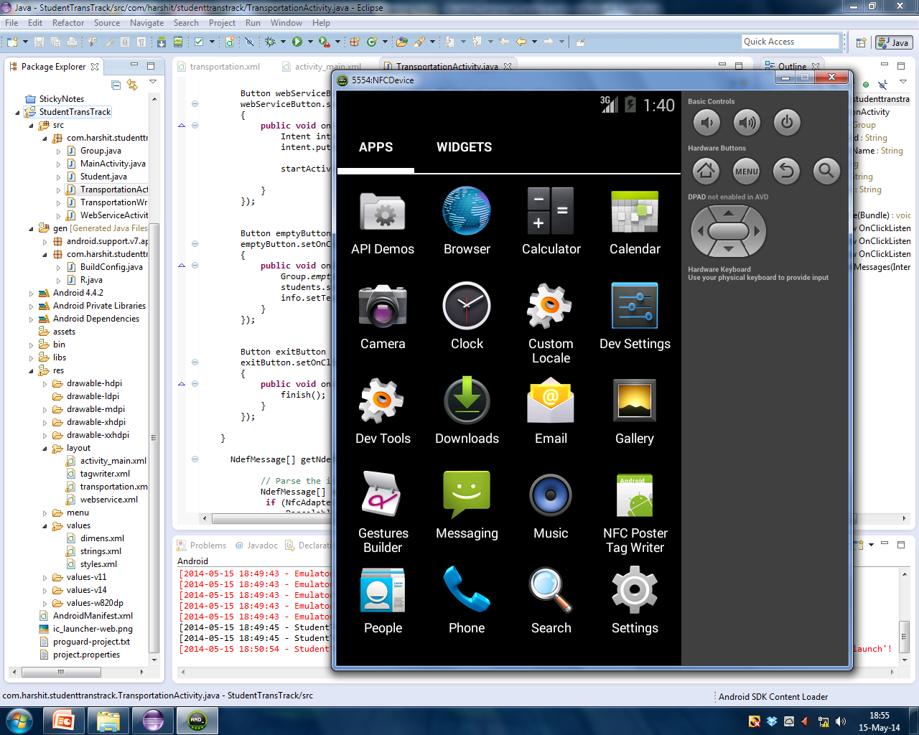
Softwares Used (contd.)
Software Development Kit (SDK):
It contains all of the lower level tools, to build, run and test our Android apps.

Slide 18
References
[1] Jonathan Simon – Head First Android Development – O’Reilly Media, Inc. (2011)
[2] Vedat, Kerem and Busra – Professional NFC Application Development For Android – Wrox Programmer To Programmer
[3] TrendBlog.net – 18 Creative And Useful Ways To Use NFC Tags With Your Smartphone – http://trendblog.net/creative-and-useful-ways-to-use-nfc-tags-with-your-smartphone/
[4] TechSpot – Everything You Need To Know About NFC - http://www.techspot.com/guides/385-everything-about-nfc/page1.html

Slide 19


